Slide 1
Data Storytelling & Statistical Validation
Global Superstore Sales Analysis
Jagan Mohan Reddy B
Data Analytics Internship – ApexPlanet Software Pvt. Ltd.

Slide 2
Business Objective
Profit instability despite strong sales performance.
Key Question: Do high discounts significantly reduce profitability?

Slide 3
Dataset Overview
Total Records: 9,994
Total Columns: 21
Key Variables: Sales, Profit, Discount, Region, Category

Slide 4
Exploratory Insights
High discount orders frequently generate losses.
Profit drops sharply above 20% discount threshold.

Slide 5
Hypothesis Testing
H0: No profit difference between discount groups.
H1: High discount orders generate lower profit.
Test Used: Independent Two-Sample T-Test

Slide 6
Statistical Results
Mean Profit (Low Discount): ₹48.84
Mean Profit (High Discount): ₹-97.18
Mean Difference: ₹146.02
P-value: 7.71 × 10⁻¹⁰⁶

Slide 7
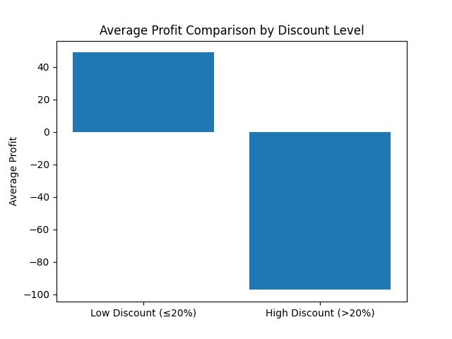
Average Profit Comparison
Bar chart showing mean profit difference.

Slide 8
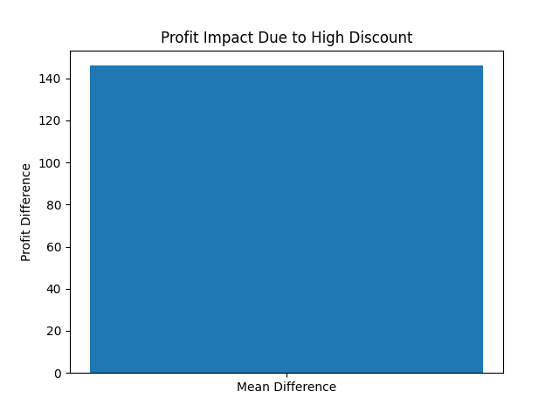
Profit Impact Visualization
Visualization of overall financial impact due to high discounts.

Slide 9
Business Impact
High discount orders generate average loss of ₹97 per order.
Strategic pricing control required to protect margins.

Slide 10
Executive Recommendation
Cap discounts between 15–20%.
Implement controlled promotional strategies.
Focus on margin-driven growth.

